Slide 1
2023 Employee Benefit Open Enrollment

Slide 2
July 1, 2023 Open Enrollment
Open Enrollment Dates: 6/5/23 – 6/16/23
All open enrollments will be made via a Salary Reduction Agreement
After open enrollment you will not be eligible to make any changes to your benefits unless you have a Qualifying Event:
Marriage, divorce or legal separation
Birth or adoption of a child
Change in child’s dependent status
Death of a spouse, domestic partner, child or other qualified dependent
Change in employment status or a change in coverage under another employer-sponsored plan

Slide 3
Defined Contribution
Amount of money that Group Main Stream provides for employees to purchase benefits
Issues in the form of a “credit” to employees
Employers financed “credits” are non-taxable, as part of Code Section 125, if “credits” are applied to the purchase of nontaxable benefits such as health, dental or vision insurance
 | Monthly Amount | Annual Amount
Medical Benefit Dollars | $575.00 | $6,900
Ancillary Benefit Dollars* | $125.00 | $1,500
*Only available for Employee’s working 35+ hours

Slide 4
Harvard Medical Plan Options

Slide 5
 | Harvard PPO $1,500 |  | Harvard POS $1,500
Plan Features | In-Network | Out-of-Network | In-Network | Out-of-Network
Deductible (Ind/Fam) | $1,500 / $3,000 | $3,000 / $6,000 | $1,500 / $3,000 | $3,000 / $6,000
Out of Pocket Max (Ind/Fam) | $4,500 / $9,000 | $9,000 / $18,000 | $4,500 / $9,000 | $9,000 / $18,000
Coinsurance | 20% | 40% | 20% | 40%
PCP Office Visit | $30 Copay | 40% after Deductible | $30 Copay | 40% after Deductible
Preventive Care Visit | $0 Copay | 40% after Deductible | $0 Copay | 40% after Deductible
Specialist Office Visit | $50 Copay | 40% after Deductible | $50 Copay | 40% after Deductible
Labs/Diagnostic & Imaging Services | 20% after Deductible | 40% after Deductible | 20% after Deductible | 40% after Deductible
Emergency Room Care | 20% after Deductible | 20% after Deductible | 20% after Deductible | 20% after Deductible
Urgent Care | $30 Copay / $50 Copay | 40% after Deductible | $30 Copay / $50 Copay | 40% after Deductible
Inpatient Hospital | 20% after Deductible | 40% after Deductible | 20% after Deductible | 40% after Deductible
Chiropractic Care | $30 Copay | 40% after Deductible | $30 Copay | 40% after Deductible
Physical, Speech and Occupational Therapy | $30 Copay | 40% after Deductible | $30 Copay | 40% after Deductible
Prescription Drugs T1- Generics T2- Preferred Brand T3- Non-Preferred Brand T4 & T5- Specialty | $10 Copay $20 Copay $35 Copay $70 Copay / 30% up to $300 Max | $10 Copay $20 Copay $35 Copay $70 Copay / 30% up to $300 Max | $10 Copay $20 Copay $35 Copay $70 Copay / 30% up to $300 Max | $10 Copay $20 Copay $35 Copay $70 Copay / 30% up to $300 Max

Slide 6
 | Harvard PPO $2,500
Plan Features | In-Network | Out-of-Network
Deductible (Ind/Fam) | $2,500 / $5,000 | $5,000 / $10,000
Out of Pocket Max (Ind/Fam) | $5,500 / $11,000 | $11,000 / $22,000
Coinsurance | 20% | 40%
PCP Office Visit | $30 Copay | 40% after Deductible
Preventive Care Visit | $0 Copay | 40% after Deductible
Specialist Office Visit | $50 Copay | 40% after Deductible
Labs/Diagnostic & Imaging Services | 20% after Deductible | 40% after Deductible
Emergency Room Care | 20% after Deductible | 20% after Deductible
Urgent Care | $30 Copay / $50 Copay | 40% after Deductible
Inpatient Hospital | 20% after Deductible | 40% after Deductible
Chiropractic Care | $30 Copay | 40% after Deductible
Physical, Speech and Occupational Therapy | $30 Copay | 40% after Deductible
Prescription Drugs T1- Generics T2- Preferred Brand T3- Non-Preferred Brand T4 & T5- Specialty | $10 Copay $20 Copay $35 Copay $70 Copay / 30% up to $300 Max | $10 Copay $20 Copay $35 Copay $70 Copay / 30% up to $300 Max

Slide 7
 | Harvard PPO HSA $3,000 |  | Harvard PPO HSA $5,000
Plan Features | In-Network | Out-of-Network | In-Network | Out-of-Network
Deductible (Ind/Fam) | $3,000 / $6,000 | $3,000 / $6,000 | $5,000 / $10,000 | $5,000 / $10,000
Out of Pocket Max (Ind/Fam) | $3,000 / $6,000 | $6,000 / $12,000 | $5,000 / $10,000 | $10,000 / $20,000
Coinsurance | 0% | 20% | 0% | 20%
PCP Office Visit | 0% after Deductible | 20% after Deductible | 0% after Deductible | 20% after Deductible
Preventive Care Visit | $0 Copay | 20% after Deductible | $0 Copay | 20% after Deductible
Specialist Office Visit | 0% after Deductible | 20% after Deductible | 0% after Deductible | 20% after Deductible
Labs/Diagnostic & Imaging Services | 0% after Deductible | 20% after Deductible | 0% after Deductible | 20% after Deductible
Emergency Room Care | 0% after Deductible | 0% after Deductible | 0% after Deductible | 0% after Deductible
Urgent Care | 0% after Deductible | 20% after Deductible | 0% after Deductible | 20% after Deductible
Inpatient Hospital | 0% after Deductible | 20% after Deductible | 0% after Deductible | 20% after Deductible
Chiropractic Care | 0% after Deductible | 20% after Deductible | 0% after Deductible | 20% after Deductible
Physical, Speech and Occupational Therapy | 0% after Deductible | 20% after Deductible | 0% after Deductible | 20% after Deductible
Prescription Drugs T1- Generics T2- Preferred Brand T3- Non-Preferred Brand T4 & T5- Specialty | 0% after Deductible 0% after Deductible 0% after Deductible 0% after Deductible | 0% after Deductible 0% after Deductible 0% after Deductible 0% after Deductible | 0% after Deductible 0% after Deductible 0% after Deductible 0% after Deductible | 0% after Deductible 0% after Deductible 0% after Deductible 0% after Deductible

Slide 8
Network with national access
In addition to Harvard Pilgrim’s network of
more than 90,000 doctors and other clinicians and
more than 180 hospitals
RI
Access to the largest national network in the USA with 1.2 million providers and more than 5,900 hospitals provided by UnitedHealthcare
PPO:
No PCP Required
No referral Necessary
Can Access in OR out of network services
*OON services may be subject to balance billing.
POS:
PCP Required
Referral Necessary
Can Access in OR out of network services
*OON services may be subject to balance billing.

Slide 9
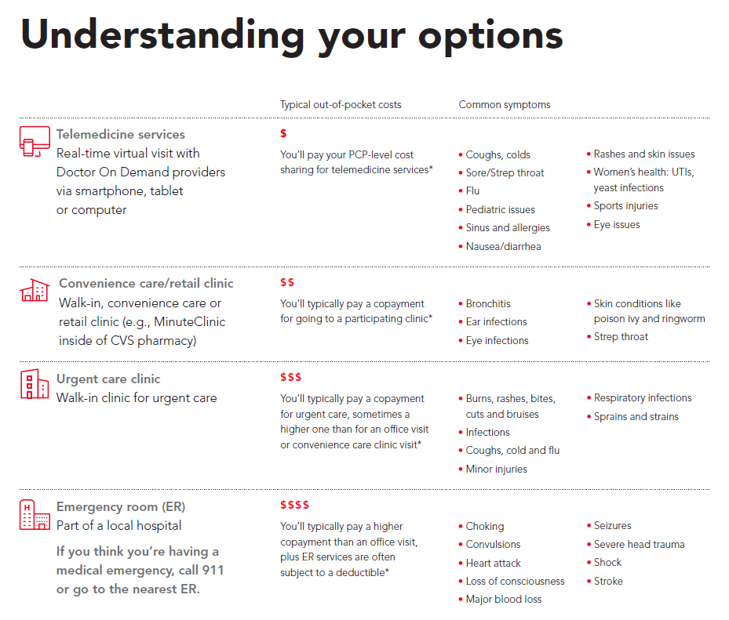
Need care when your primary provider isn’t available? You have options!
If you need immediate care, but don’t think you need to go to an emergency room (ER) consider accessing Harvard Pilgrim telemedicine services or going to a Harvard Pilgrim participating urgent care center. These options can get you taken care of more quickly and cost you less.

Slide 10
Virtual Visits Get care from where you are with just a device and an internet connection.
Get care from licensed medical doctors, psychologists and psychiatrists
Receive convenient and private care from your home or any location
Urgent Medical Care Options
Behavioral Health Care Options
Connect with Doctor On Demand providers
Easily access behavioral health services
Download the free Doctor On Demand app or create an account at www.doctorondemand.com
Go to www.harvardpilgrim.org and click “Find a provider” at the top of the page
If you have created a Harvard Pilgrim member account, click “Login to search,” or click “Select a plan” and then the link for your plan.
Click “Behavioral Health” on the right.
Choose your Behavioral Health provider type, then “Virtual Visits/Telemedicine” on the left.
Harvard Pilgrim’s provider network: Some providers may offer telemedicine services to patients. We recommend that you consult with your PCP office and/or the offices of other providers you see to learn about any offerings they have.

Slide 11
Harvard Pilgrim - Reduce My Costs
Pay less in out-of-pocket expenses for procedures and tests. And get cash rewards.
How Reduce My Costs works:
Call (855) 772-8366 whenever your doctor recommends an outpatient test or procedure.
The Reduce My Costs line is available Monday through Friday from 8 a.m. – 6 p.m. Or, log into your Harvard Pilgrim member account to chat with Reduce My Costs.
You’ll speak with an experienced nurse who will:
Compare provider costs and inform you of the lower-cost providers in your area.
Assist with scheduling or rescheduling your appointment and help with any paperwork.
If you’re already seeing a lower-cost provider, you’ll receive a reward just for calling.
If you decide to receive care from a lower-cost provider, you will earn a cash reward, depending on the service and the associated cost savings.
Radiology (e.g., MRI and CT scan), Lab work, Mammogram, Ultrasound, Bone density study, Colonoscopy, Other non-emergency outpatient tests and procedures

Slide 12
Get rewards and feel your best Earn up to $120 each year
harvardpilgrim.org/livingwelleveryday
Being rewarded for taking care of myself
It’s a fun and easy way to connect
Subscriber Rewards
Level 1 $20
EARN
Level 2 $40
EARN
Earning rewards to feel my best!
Spend a minute breathing
Level 3 $60
EARN
Annual subscriber rewards total $120 in Amazon gift cards
Covered dependents and employees who aren’t Harvard Pilgrim members can participate in a separate program, where they earn points towards monthly Amazon gift card drawings.

Slide 13
Flexible Fitness Reimbursement Options
Get reimbursed* for fees you pay toward a fitness facility or other qualified membership.
Full-service health clubs (provide cardiovascular & strength-training equipment ― most fitness centers, YMCAs and JCCs qualify)
Specialty fitness studios/facilities offering yoga, Pilates, Zumba, aerobic/group classes, indoor cycling/spinning classes, kickboxing, CrossFit, strength training, tennis, indoor rock climbing and personal training (taught by a certified instructor).
Up to $150 per Harvard Pilgrim member, $300 per family per calendar year.
Did you know? Virtual fitness class subscriptions also qualify!
Harvard Pilgrim membership must be at least four months in a calendar year and coincide with at least four months of health club or fitness facility membership.
harvardpilgrim.org/public/discounts-savings/fitness-reimbursement

Slide 14
Health Savings Account (HSA)

Slide 15
Health Savings Account (HSA)
Why have an HSA Plan?
Security
Can provide a savings plan for unexpected or high medical bills
Affordability
Lower monthly health insurance premiums
Pre taxed contributions to lower taxable income
Flexibility
Can use for current expenses
Can save to cover future expenses
Out-of-Pocket expenses when covered by Medicare
Long-term care expenses and insurance

Slide 16
Health Savings Account (HSA)
Employees who are enrolled in the PPO HSA plans are eligible to establish an HSA
Establish the HSA through Paylocity
2023 Contribution Limits
$3,850 for Employee only plan
$7,750 for Employee plus dependents plan
Catch Up Contribution for age 55 and older $1,000
*HSA funds can only be used to pay for services incurred after the account is open

Slide 17
Anthem Plan Options

Slide 18
Dental Core Plan
Benefit | In-Network
Calendar Deductible (Individual/Family) Applies to Basic and Major ONLY | $50 / $150
Calendar Year Maximum Benefit Preventive and Diagnostic, Basic and Major Services Combined | $1,000
Preventive and Diagnostic Services Routine Exam (2 per 12 months), Bitewing X-rays (1 per 12 months), Full Mouth/Panoramic X-rays (1 in 60 months), Cleaning (2 per 12 months), Fluoride for Children 15 and under (1 per calendar year), Sealants (age 15 and under) and Space Maintainers to age 15 | 100%
Basic Services Restorative Amalgams, Restorative Composites, Endodontics, Periodontics and Simple/Complex Extractions | 70% after deductible
Major Services Onlays, Crowns (1 in 60 months per tooth), Crown Repair, Denture Repair, Prosthodontics (fixed bridge, removable completed/partial dentures), Implants (1 in 60 months per tooth) | 50% after deductible

Slide 19
Dental Enhanced Plan
Benefit | In-Network
Calendar Deductible (Individual/Family) Applies to Basic and Major ONLY | $50 / $150
Calendar Year Maximum Benefit Preventive and Diagnostic, Basic and Major Services Combined | $1,500
Preventive and Diagnostic Services Routine Exam (2 per 12 months), Bitewing X-rays (1 per 12 months), Full Mouth/Panoramic X-rays (1 in 60 months), Cleaning (2 per 12 months), Fluoride for Children 15 and under (1 per calendar year), Sealants (age 15 and under) and Space Maintainers to age 15 | 100%
Basic Services Restorative Amalgams, Restorative Composites, Endodontics, Periodontics and Simple/Complex Extractions | 90% after deductible
Major Services Onlays, Crowns (1 in 60 months per tooth), Crown Repair, Denture Repair, Prosthodontics (fixed bridge, removable completed/partial dentures), Implants (1 in 60 months per tooth) | 60% after deductible
Orthodontic Services *Dependent children only through 18 | 50%
Orthodontic Lifetime Maximum Benefit | $1,000

Slide 20
Vision Plan
Benefit | In-Network | Out-of-Network
Eye Exam (once every 12 months) | $10 Copay | Plan pays up to $42
Elective Contact Lens Evaluation and Fitting (once every 12 months) | Up to $55 Copay | Not Covered
Glasses Frames (once every 24 months) | $200 Allowance, 20% off remaining balance | Plan pays up to $45
Glasses Lenses (once every 12 months) Single Bifocal Trifocal | Covered at 100% after $25 Copay You may choose to upgrade your lenses at a discounted cost | Plan pays up to $40 Plan pays up to $60 Plan pays up to $80
Contact Lenses (once every 12 months instead of glasses) | Disposable - $200 Allowance, 15% off remaining balance Medically necessary contact lenses covered at 100% | Disposable – Plan pays up to $105 Medically Necessary – Plan pays up to $210

Slide 21
Life & AD&D Insurance 100% paid for by Group Main Stream
Life & AD&D | Spouse
Benefit – Employee | $10,000
Age Reduction | Benefit reduces 35% at age 65 and an additional 15% at age 70
Make sure beneficiary is up to date for your life coverage, this can be changed at anytime.

Slide 22
Voluntary Life & AD&D Insurance
Life Benefit | Employee | Spouse | Children
Amount | $25,000 Increments | $5,000 Increments | Choice of $2,000 increments up to $10,000*
Minimum Amount | $25,000 | $5,000 | Up to 6 Months $1,000 6 Months to 19 years $10,000
Maximum Amount | Lesser of 5X Salary or $300,000 | $100,000* *Cannot exceed 100% of Employee Election | Up to 6 Months $1,000 6 Months to 19 years $10,000
Guaranteed Issue Amount | $150,000 | $30,000 | Up to 6 Months $1,000 6 Months to 19 years $10,000
Age Reduction | Benefit reduces 35% at age 75 and an additional 20% at age 80 |  | N/A
*Age 15 days to 26 years
Open enrollment for this benefit only occurs when an employee is FIRST eligible for this benefit
Make sure beneficiary is up to date for your life coverage, this can be changed at anytime. Employee must be primary beneficiary for all dependent life coverage.

Slide 23
Voluntary Short Term Disability Insurance
Plan Features | Benefit
Maximum Weekly Benefit | 60% of weekly salary up to $1,200 per week
Elimination Period | Benefits begin on: 8th day for Accident 8th day for Illness
Maximum Benefit Duration | 26 Weeks
Pre-Existing Conditions | 3/12
Elimination Period – this is the number of days that must pass between your first day of a covered disability and the day you can begin to receive your disability benefits.
Benefit Duration – the maximum number of weeks you can receive benefits while you are disabled.
Open enrollment for this benefit only occurs when an employee is FIRST eligible for this benefit

Slide 24
Voluntary Long Term Disability Insurance
Plan Features | Benefit
Maximum Monthly Benefit | 50% of monthly salary up to $6,000 per month
Elimination Period | 180 Calendar Days
Maximum Benefit Duration | To Social Security Normal Retirement Age
Pre-Existing Condition | 3/12
Elimination Period – this is the number of days that must pass between your first day of a covered disability and the day you can begin to receive your disability benefits.
Benefit Duration – the maximum number of weeks you can receive benefits while you are disabled.
Open enrollment for this benefit only occurs when an employee is FIRST eligible for this benefit

Slide 25
Accident Coverage
$50 Wellness Benefit

Slide 26
Critical Illness Coverage
$50 Wellness Benefit
Benefit | Employee | Spouse | Children
Amount | $20,000 | 50% of Employee Election | 50% of Employee Election
Guaranteed Issue Amount | $20,000 | $10,000 | $10,000

Slide 27
Critical Illness Insurance
Covered Illnesses* | % of scheduled benefit for first occurrence
Alzheimer’s Disease | 100%
Benign Brain Tumor | 100%
Carcinoma in Situ | 25%
Coma | 100%
Coronary Artery Disease | 25%
Heart Attack | 100%
Invasive Cancer | 100%
Major Organ Failure | 100%
Multiple Sclerosis | 100%
Parkinson’s Disease | 100%
Stroke | 100%
* This is not a complete list of covered illnesses, please refer to your schedule of benefits

Slide 28
Resource Advisor*
*Included with Disability Coverage

Slide 29
Resource Advisor*
*Included with Disability Coverage

Slide 30
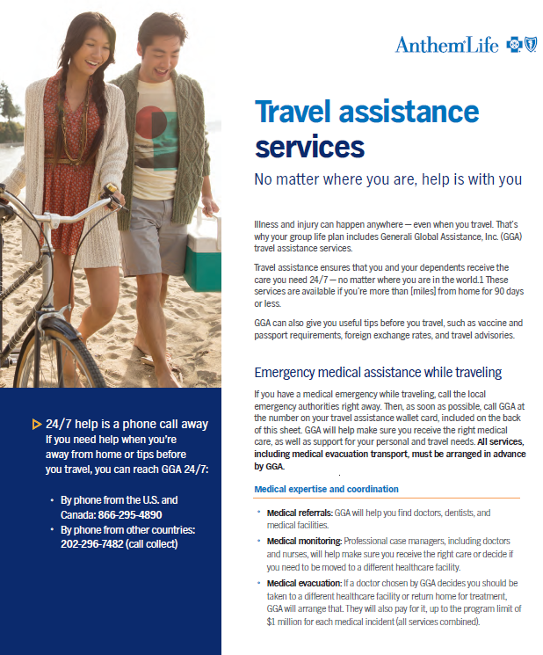
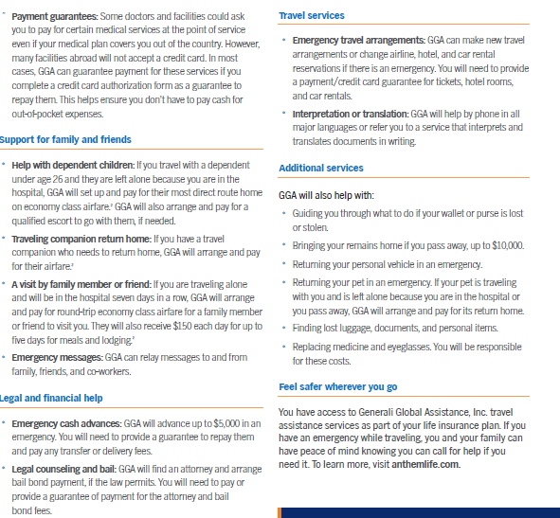
Travel Assistance*
*Included with Disability Coverage

Slide 31
Additional Plan Options

Slide 32
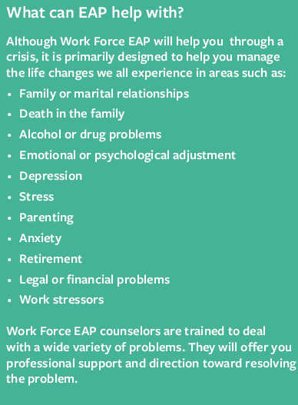

Slide 33
Pet Insurance

Slide 34
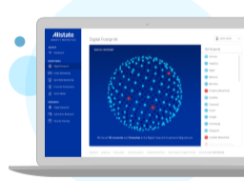
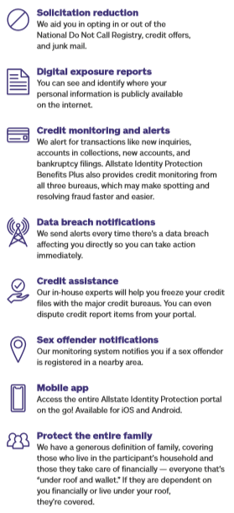
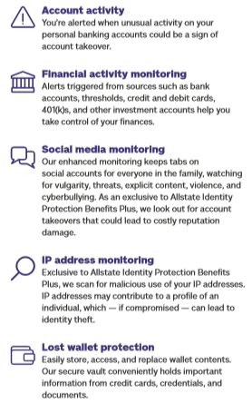
ID Theft

Slide 35
Q & A Thank you! Jessika Williams Account Executive Jessika.williams@crossagency.com 207-523-2406

